Slide 1

Midterm Presentation
By
Dazhi Li
dl939(NetID)

Slide 2
Overview
This is a program coded by python which is about how to use Bayesian curve fitting on polynomial curve fitting to predict the price of the stock market.
Use case
Download stock data
Curve fitting algorithms
Overfitting solution
Auto adjusted w, M
Predicted Result

Slide 3
Use case
The program only support predicting the close price of a stock in 5 days
User could choose any kind of stock, not limited to Apple Inc.
Training stock data set volume could be adjusted by the demand of user
Due to the effect of COVID-19, the stock price is unpredictable recently,
history data would be used as my example

Slide 4
Stock Price Download
History data of stock price could be downloaded by python package
Pandas-datareader
Stock data are fetched on Yahoo-Finance !
Stock data includes daily open price, close price, highest price, lowest price and trade volume
We only use close price as the stock price trend

Slide 5
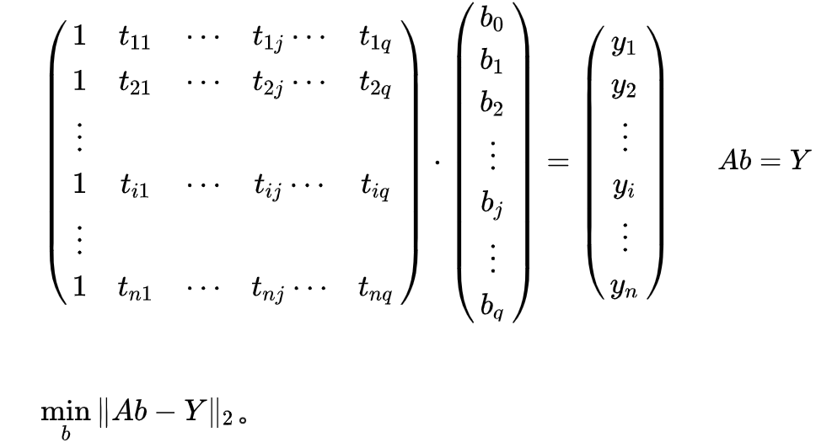
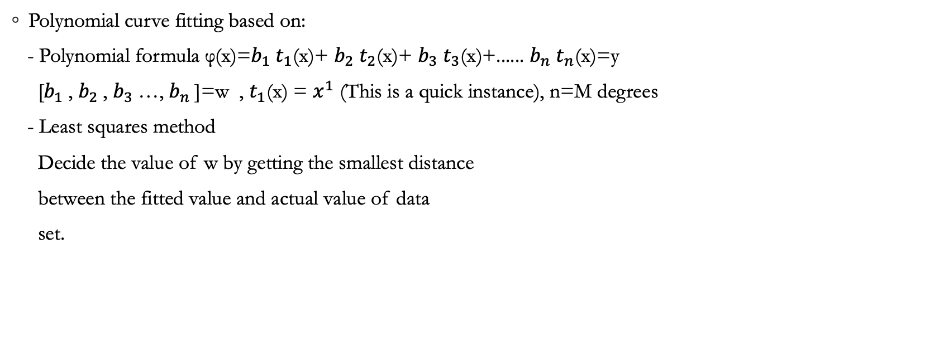
Curve Fitting Algorithms
Polynomial curve fitting based on:
- Polynomial formula φ(x)=$b_{1} t_{1}$(x)+ $b_{2} t_{2}$(x)+ $b_{3} t_{3}$(x)+...... $b_{n} t_{n}$(x)=y
[$b_{1}$, $b_{2}$, $b_{3}$…, $b_{n}$]=w , $t_{1}$(x) = $x^{1}$ (This is a quick instance), n=M degrees
- Least squares method
Decide the value of w by getting the smallest distance
between the fitted value and actual value of data
set.

Slide 6



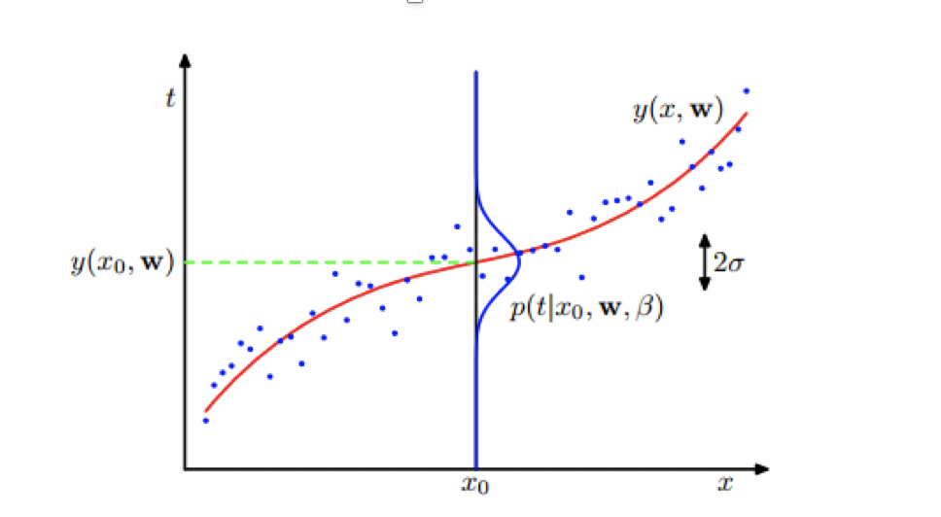
Curve Fitting Algorithms
Bayesian curve fitting
- On a fixed polynomial formula
- Using a Gaussian distribution to predict
We assume that the price of the stock on the
polynomial curve obey the Gaussian distribution
We take the mean of the distribution as the
predicted result

Slide 7
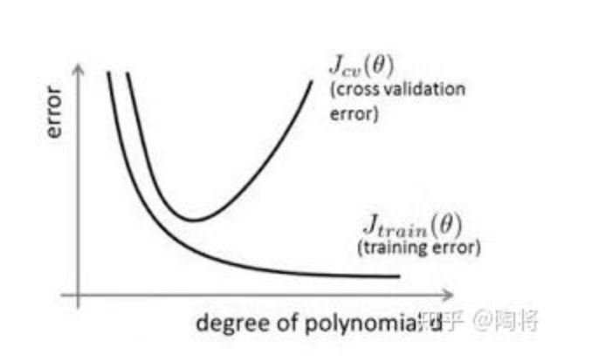
Overfitting Solution
On the progress of getting the max posterior distribution of Bayesian curve fitting, I found out the loss function of it respects to w is a regularity expression, which means we the Bayesian will naturally prevent overfitting by that regularity function.
Polynomial overfitting
- Early-stop
With the increase of M of polynomial we could fit the
curve better on the training data, but the cross validation
will reach a peak. I am using validation set to find the
peak and stop the growth of M.

Slide 8

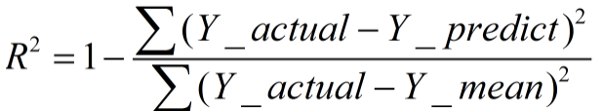
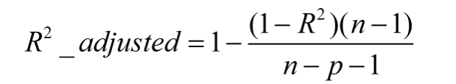
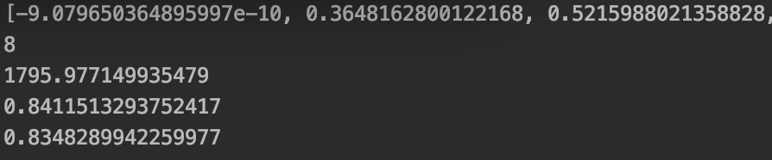
Auto Adjusted Parameters
Fitting metrics
- SSE：The sum of squares due to error
- R-square：Coefficient of determination (closer to 1, bet fitted)
- Adjusted R-square：Degree-of-freedom adjusted coefficient of determination
Method:
Set M to 0, growing to 19
Find the best adjusted R-square with early stop method and pick the value of M

Slide 9
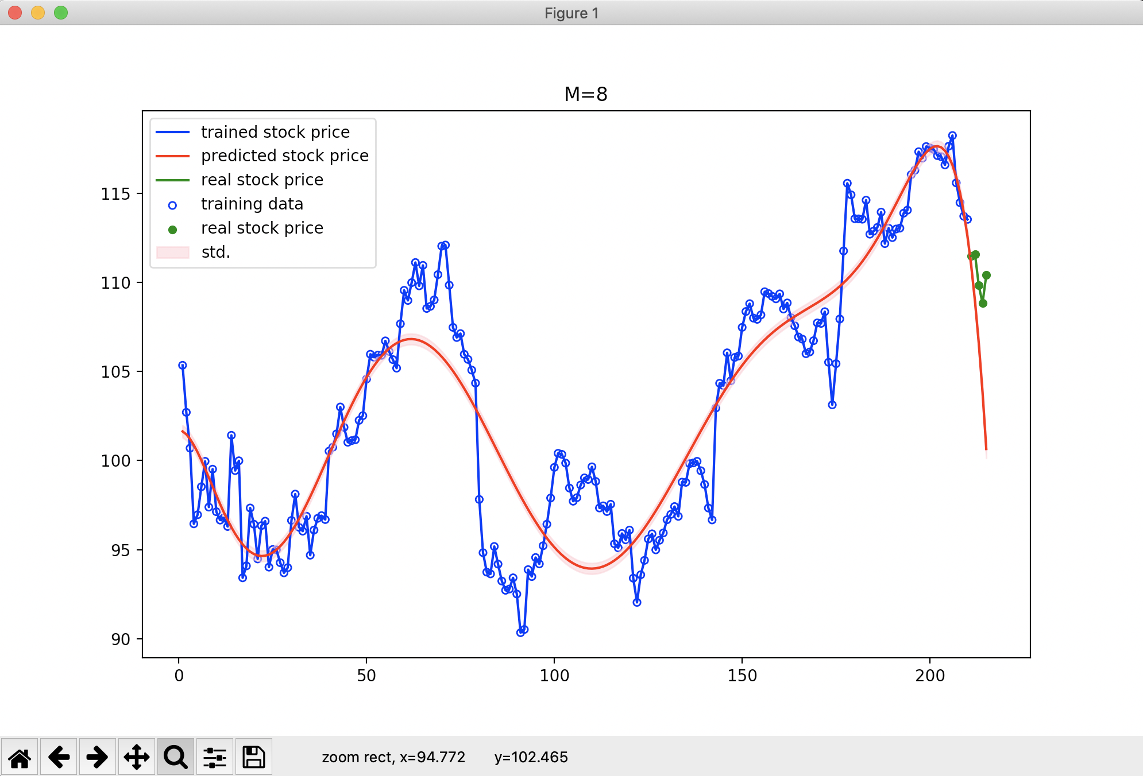
Predicted Results
Stock: AAPL
From 2016.1,1 to 2017.1.1
Local:
Predict 5 days, using the trend
Correct=3/5
Brief trend correct
Global:
True Positive Rate:0.5
Ture Negative Rate:0.7
Accuracy:0.63
Precision:0.46

